Slide 1
Scrap Book of Design Critiques
by
Rohit Maddipudi
HF 770
03/03/2013
Bentley University

Slide 2
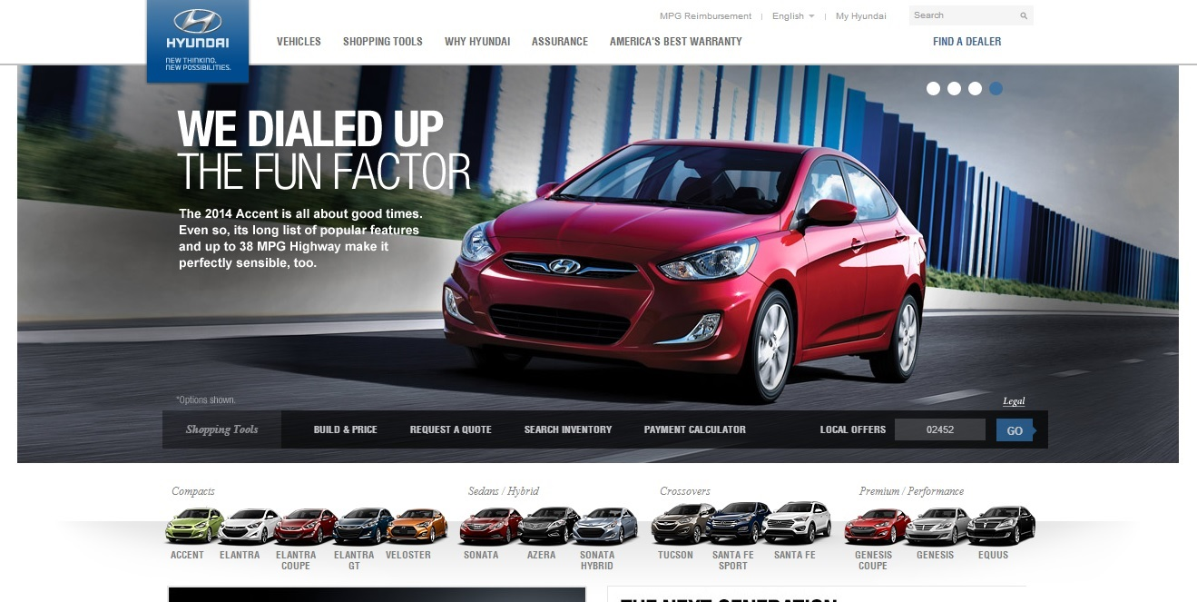
First Example
Product name : Hyundai USA website home screen and “Build & Price” screens
Source : www.hyundaiusa.com
Feeling : Business Like
The structure of the website looks more focused on providing the user with most relevant information such as; different models of the vehicles and price of the vehicles, and other secondary features of the website such as Build & price.
The website seemed to concur with the mental model of a user who wants to buy a car and will be looking for basic information of different models, price and other aspects of buying a car.

Slide 3
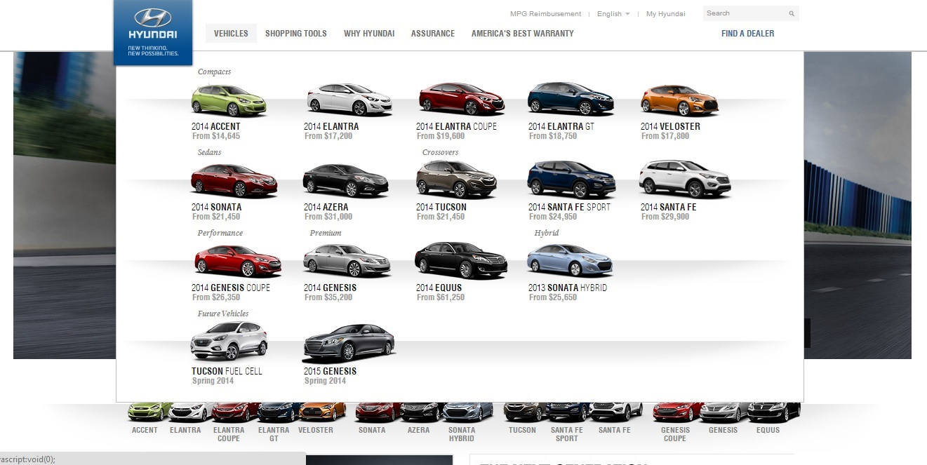
First Example
The grouping of vehicles in the ‘Vehicles tab’ although looks clean. It doesn’t do a good job of grouping the vehicle models since the naming on the models doesn’t quite provide the support to differentiate as the grouping.

Slide 4
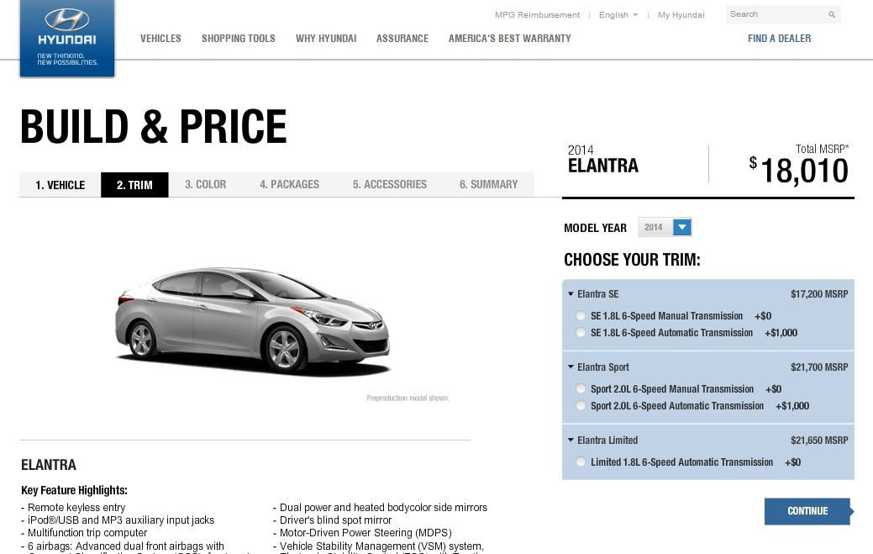
First Example
In build & price functionality of the site, the tabs are disabled to click if the radio buttons are not clicked which prevents the errors while the same tab gets enabled to navigate back and forth once the user fills all the information on different tabs providing flexibility.
The placement of the ‘continue’ button nears the radio buttons complements the Fitt’s Law making the function easy and efficient.
The Overall Design of the website considerably has High signal to noise ratio which helps the users to perform the tasks better as well as the perception of the brand.

Slide 5
First Example
Visual Complexity of the Build & own page of the website:
Formula for Visual Complexity: No. of elements + No. of Vertical Lines + No. of Horizontal Lines
No. of elements = 29 ; No. of Horizontal Lines = 16; No. of Vertical Lines = 17
Visual Complexity = 29 + 16 + 17 = 62
Assumptions:
- I considered each tab or section in the menu and the Build section as individual elements.
- I considered the set of options as elements based on the colored grouping in ‘Choose your trim’ options.
- I considered the top right search function as an individual element from the rest in the same horizontal section.

Slide 6
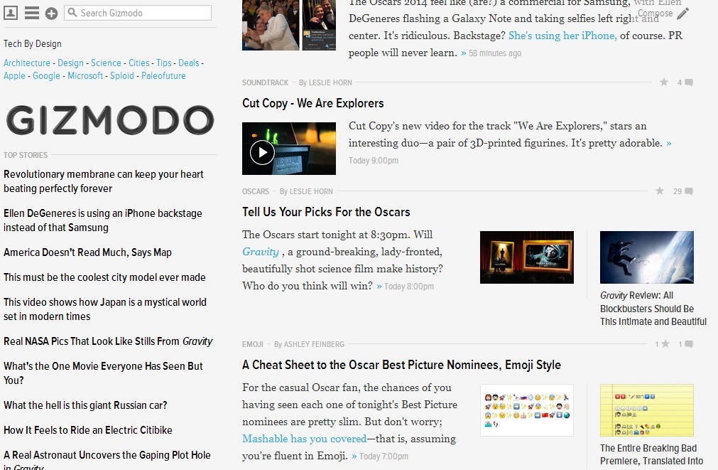
Second Example
Product name : Gizmodo.com; a news bloopers site
Source : http://gizmodo.com/
Feeling : Confusing Design

Slide 7
Second Example
Critiques:
The Structure of the website is confusing without any hierarchy violating the mental models of the news readers.
There is no main menu to understand the structure of the website making it hard to access the content efficiently.
The page when clicked on an article takes to a new article without any visible indication of the main site which makes is hard to be trust worthy and confusing to the user.
The alignment of the information on the homepage is good but the display of content inside the article make them hard to read with the mix of static and dynamic panel creating a distraction to the user.
There is no clear distinction between the article panels and the content which also makes it hard to focus on the content.

Slide 8
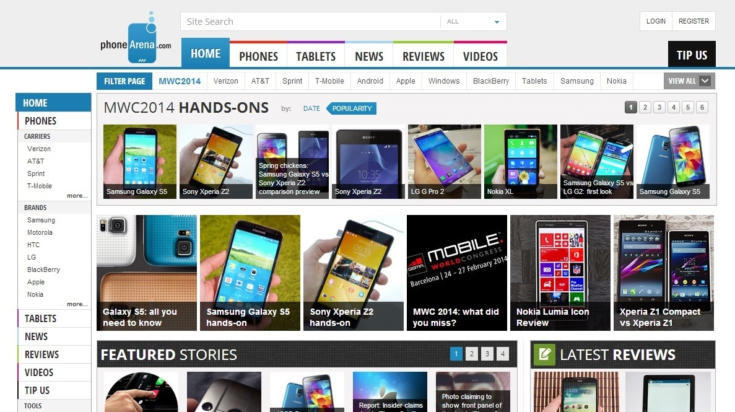
Third Example
Product name : www.phonearena.com
Source : http://www.phonearena.com/
Feeling : Cluttered Design
On clicking these tabs, there is no response or feedback of the action.
The display of information is vague and cluttered with very close grouping of different sections
The side navigation panel doesn’t respond to the clicks providing inconsistent information based on the top Main menu creating ambiguity and ill feedback to the users.

Slide 9
Third Example
Cluttered information presentation making it hard to navigate and focus.
Inconsistent feedback for navigation through navigation bars.
Low signal to noise ratio with data overload.
High visual complexity with various elements on a single screen.

