Slide 1
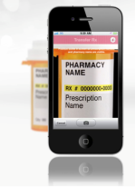
Rich picture – Concerns in creating a Medication Reminder App
Data about drugs?
ROI for the App
Primary stakeholders
Investors
Where to start ? Project requirements?
Drug manufacturers
Medication reminder App
Employees
App design conformity
Medicine refills
Accessibility and cost ?
Elderly people
Compliance and reliability
Shared information
Supply channels
E- prescriptions
Legend:
Conflict
Family Members
Doctors
Government Bodies

