Slide 1
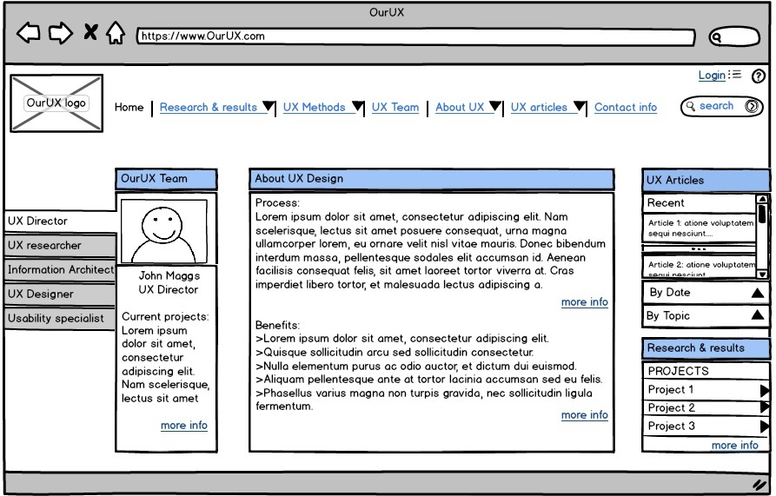
UX Homepage Wireframe with annotations – Rohit Maddipudi – 04/22
Legend: - Annotation; - Clickable object for display of more sectional information
1
1
7
2
3
4
5
6

Slide 2
Annotations
- Global Navigation bar with different sections and drop down sub sections for ease of navigation.
- Login functionality for secured information such as current projects to be accessed by UX team. Help icon for information about the site content.
- Basic info on UX team for easy recognition for other colleagues. Users can click on “more info” icon for further information on each team member.
- Brief information about UX and its benefits for educating colleagues in the company. Users can look at more information through “more info” icon.
- Quick reference for UX articles categorized by topic and recent articles.
- Information about prior UX research and results categorized by projects for quick information for business colleagues.
- The “research & results” section in the navigation will be replaced by “My research” when UX team members login to the site which has all the information about research by project, current projects, completed projects & results.
1
2
3
4
5
6
7

Slide 3
Experiences creating the wireframe
Information about the users has given a basic understanding of the requirements of the content layout for ease of content consumption such as recent articles and description about the UX on the homepage.
Changes have been made based on the general browser display resolution.
This wireframe has been designed for minimal information display where information is limited to 4 or 5 major sections. More information about the actual content might require changes in the layout.
More information on how the information is shared across teams within a company would have helped in understanding the flow of wireframes which might changes the content and other navigational elements on the wireframe.
Prototyping tools: This wireframe has been created on Blasamiq but learnt that low fidelity, non interactive and static webpages can be created faster through paper prototyping.
Iterations: Multiple iterations had to be created for the layout to display relevant content on the homepage without causing information overload to the users.
Annotations: The annotations have been provided to support any queries that users might have and felt that annotations help in explaining the actions without implementing interactions and details.

