Slide 1
Home Helper
Decision support for real estate purchasing
Patrick Day, Lisa Lokshin, Rohit Maddipudi, Sandra Niehaus, Markus Sieber

Slide 2
The Problem
Real estate purchasing is a complex, difficult decision which involves both objective and emotional factors.
Primary considerations include
Budget
Location
Required / desired amenities
Available inventory

Slide 3
Solution: Home Helper
An intelligent discussion engine that aids prospective homebuyers in their decision process.
Prompts user to justify and prioritize home search criteria
Helps prioritize criteria at odds with each other
Offers integrated community support to help refine search and weigh available home options
Serves as useful documentation tool for search and decision-making process

Slide 4
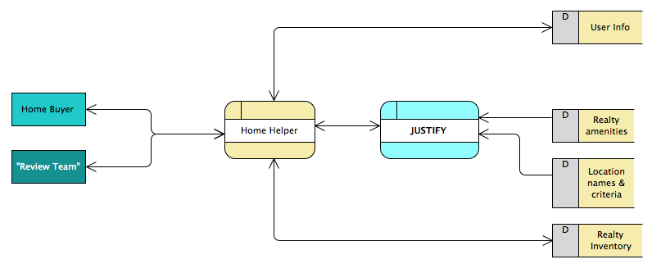
Data Flow and Limitations

Slide 5
Data Flow and Limitations
Current limitation: an API (web service) is needed to allow data to be posted into, and requested out of Justify.

Slide 6
Prototype

Slide 7
Scenario
First Time Home Buyers
Andrew and Melissa Roberts, 35 and 33 years old
Budget: $350 K
Looking to buy in Boston area
Recently married, looking for a starter home
Hoping to grow their family in the next few years
Inexperienced w. real estate market; not sure where to begin
Know their general requirements; unsure of priorities

Slide 8
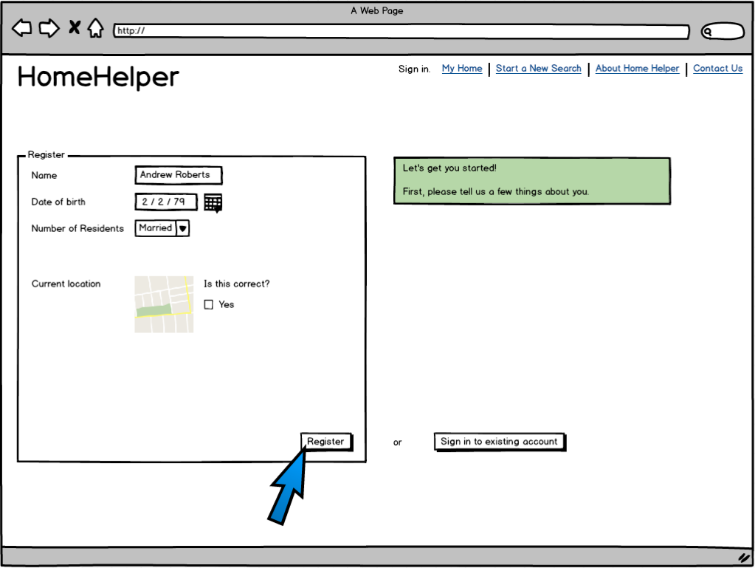

Slide 9
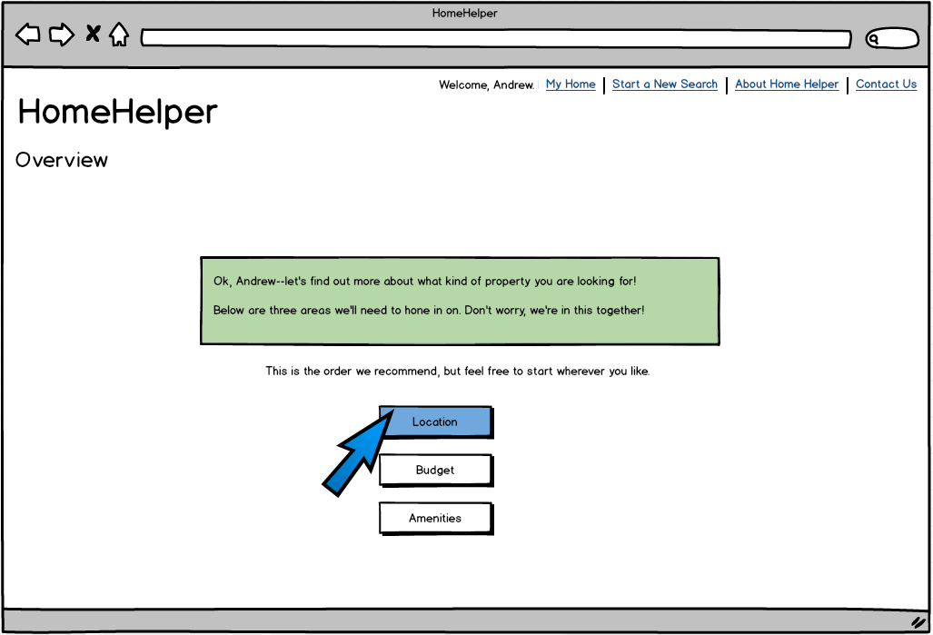

Slide 10
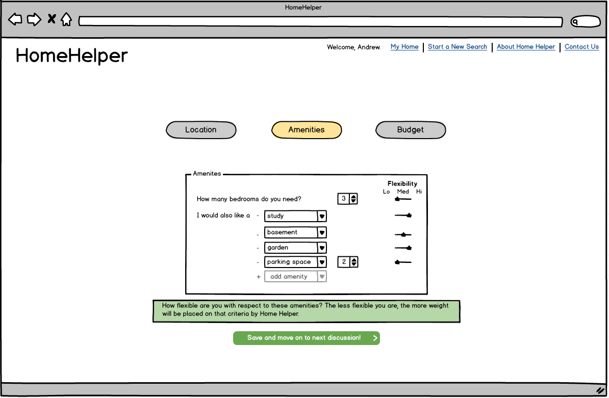

Slide 11
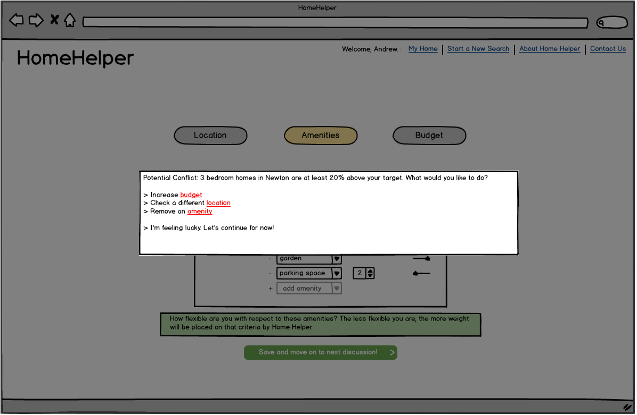

Slide 12
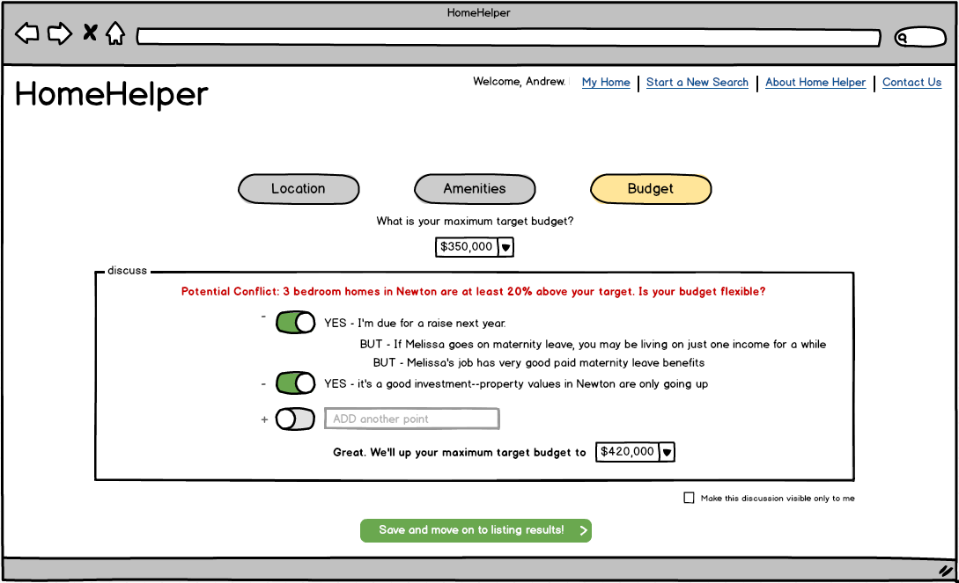

Slide 13
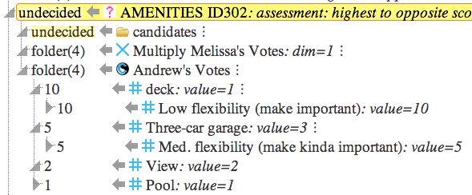
Meanwhile,
inside Justify...

Slide 14
Meanwhile,
inside Justify...

Slide 15
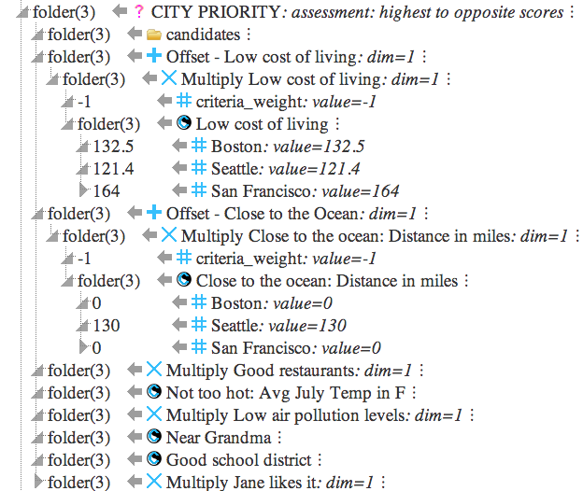
Meanwhile,
inside Justify...
Integrating
real-world data
Integrating
real-world data

Slide 16
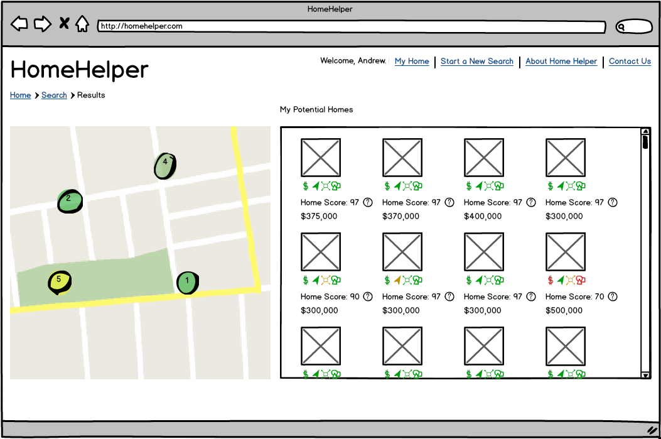

Slide 17
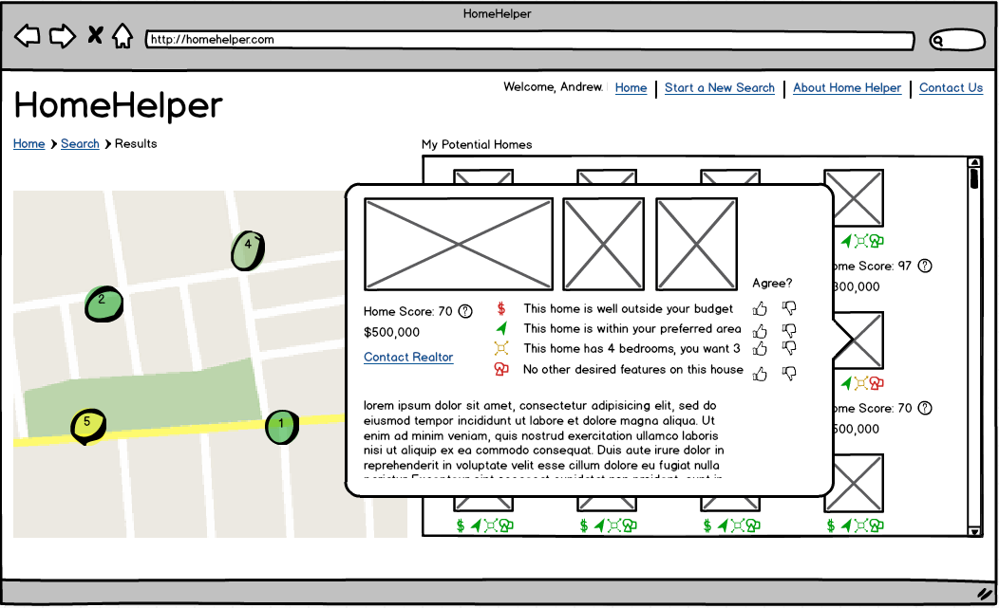

Slide 18
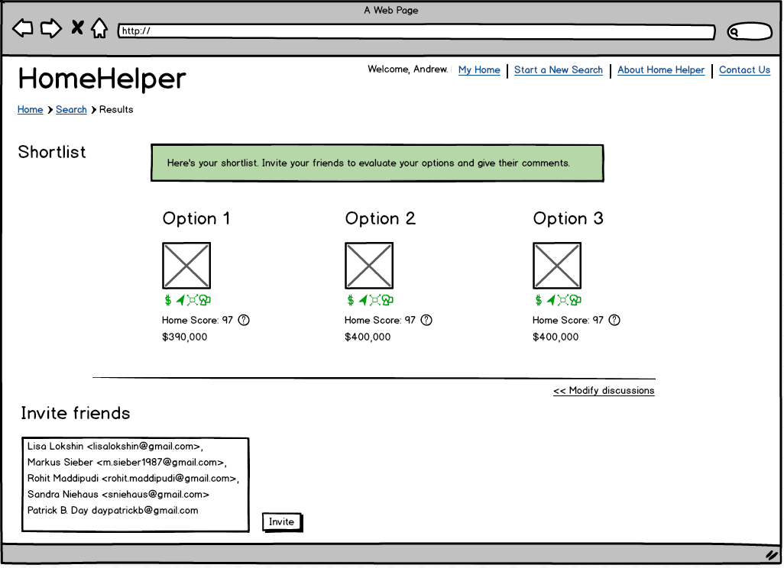

Slide 19
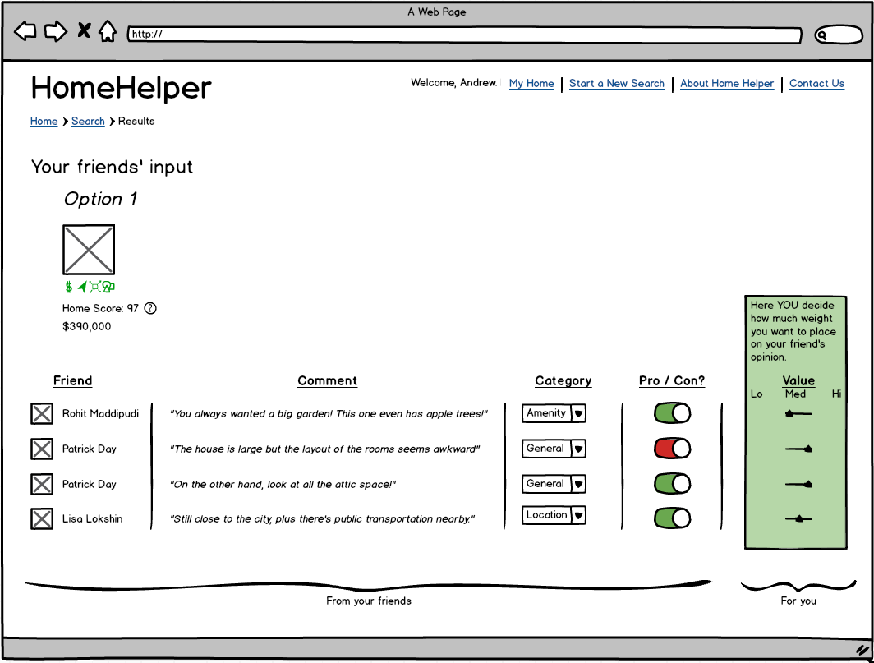

Slide 20
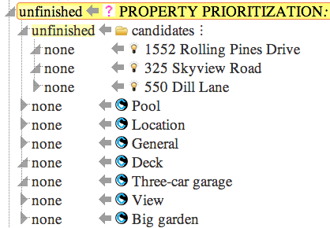
Meanwhile,
inside Justify...

Slide 21
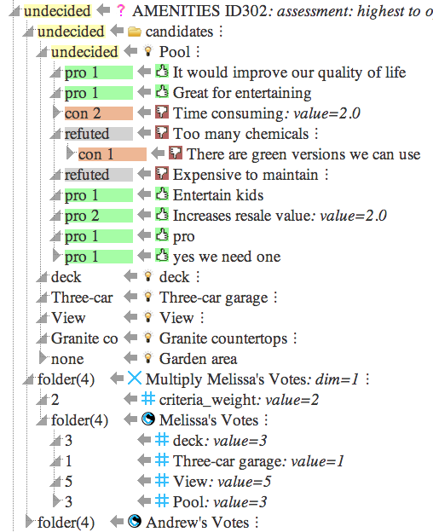
Community discussion:
due to ongoing Justify
server issues, showing
this example
Debating candidates
Weighting
Weighting

Slide 22
Closing Thoughts
Current Functionalities
Valuable tool for weighting and prioritization, which can be applied in each phase of home-shopping
Useful documentation method for decision process
Considerations for the future
Justify could offer additional domain-specific value by accessing external real-estate resources.

Slide 23
Thank you

Slide 24
APPENDIX

Slide 25
